Slide 1
Samsung Innovation Campus
Artificial Intelligence Course
Notes:
Note:
1

Slide 2
Spam Text Message Classification
Project presented by :
Marwan Mohamed
Marwan Makhlouf
Mohamed Sameh
Facilitator:-
Eng. shimaa Othman
Data Used : https://www.kaggle.com/team-ai/spam-text-message-classification
Notes:
Note:
2

Slide 3
Agenda
About project
Visualization
Model
Testing & API
Notes:
Note:
3

Slide 4
About Data
The dataset holds 5157 messages which are tagged as ham or as spam
Our job:-
Build a predictive model that classifies mails into SPAM or HAM.

Slide 5
Spam messages
Also referred to as junk email, unwanted, and virus-infested email which sent randomly in bulk by email (spamming).
Most email spam messages are commercial for advertising purposes and most of them are dangerous because they may contain links that lead to phishing web sites or dangerous malwares.

Slide 6
Ham messages
Usually they are desired mails that are not spam.
They are mails that you receive while downloading free software such as browsers, games or signing up for a new online service by agreeing to their Terms of Service(which is usually a check box).

Slide 7
Why that?
In today’s world, spam filtering is a must to protect your business by filtering your mails and keep you focused on your important mails.
Because nowadays the average spam email messages sent every day have reached 54 billion messages based on statistics in 2014, and the volume of spam continues to grow each day. Spammers get more sophisticated and creative in their tactics to get their messages into your inboxes. Spam filtering solutions must continually be updated to address there evolving techniques.

Slide 8
Reasons
Email have become one of the most important and powerful communication ways in personal lives and business these days
it is vital for operations to run smoothly as well as for establishing stable and positive relations with customers and classifying can have a great impact on customer support.
since failing to do so risk negatively affect both the image and the reputation of the corporation.
Spam prevents the user from making full and good use of time, storage capacity and The huge volume of spam mails flowing through the computer networks have destructive effects on the memory space of email servers, CPU power and user time

Slide 9
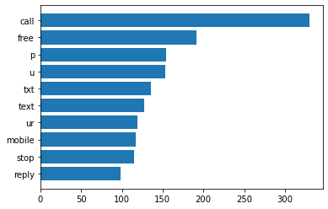
The top and most common words in spam emails
Visualization Spam features

Slide 10
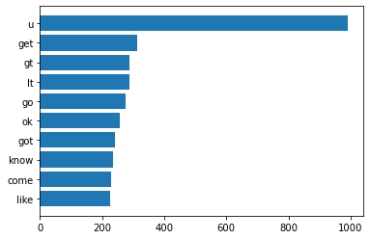
Ham (non spam)
The top and most common words in non spam emails

Slide 11
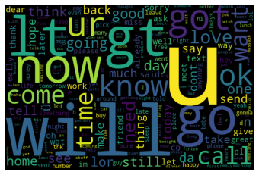
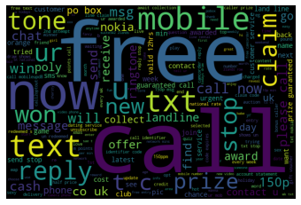
Ham Spam Word Cloud of Spam text can clearly show some unique words that appear in Text body, this mainly includes free, text, call, txt, mobile, reply etc.

Slide 12
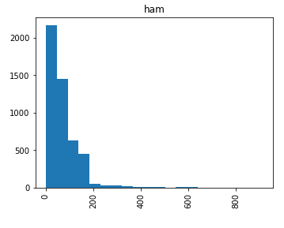
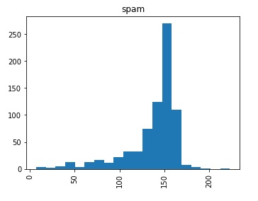
We can clearly see that the spam emails contains less numbers of words but these words contains the top and most common words so the word count plays a significant role in spam detecting

Slide 13
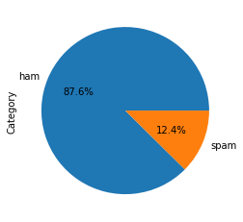
12% of all the messages are spam 88% of the messages are ham.

Slide 14
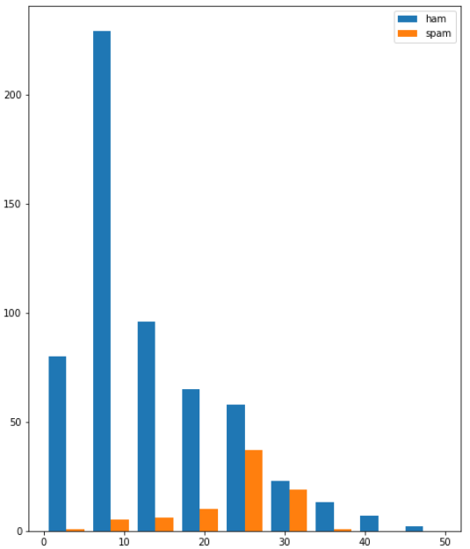
the ham messages contain 0 to 10 spam messages are longer and contain between 20 to 30 words.

Slide 15
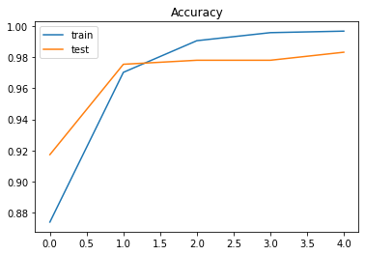
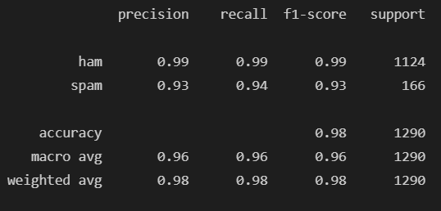
Modeling using LSTM

Slide 16
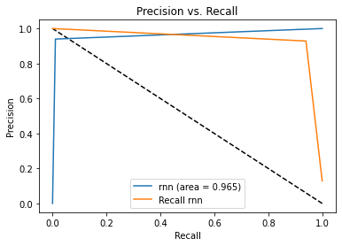
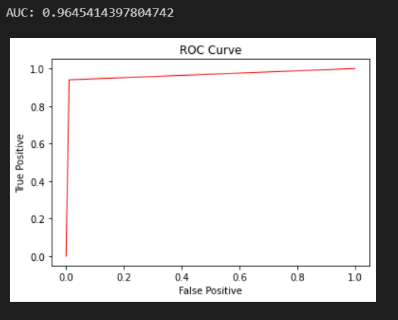

Slide 17
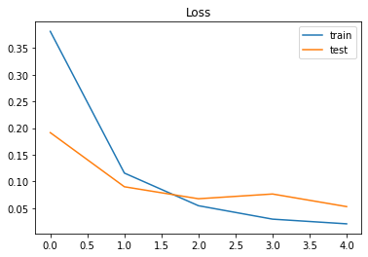
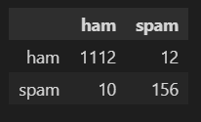
confusion matrix

Slide 18
Testing & API
API & Testing
Source code
GitHub

Slide 19
Thank You

